Slide 1
Deep Neural Network의 backpropagation 이해
Part 2

Slide 2
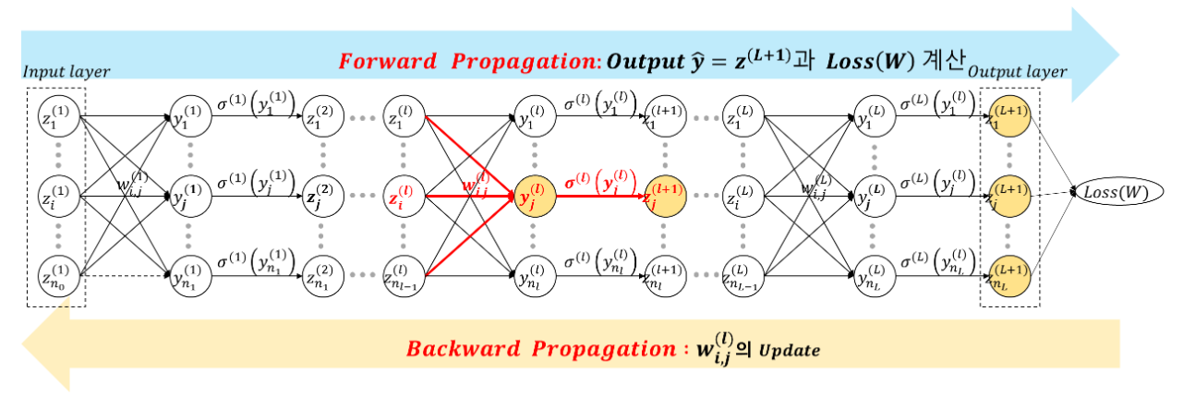
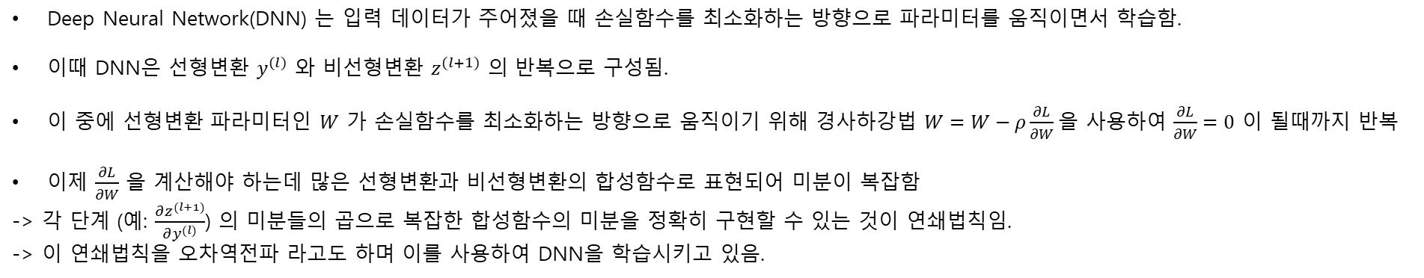
03_05 Backpropagation 이해하기 (참고)
Deep Neural Network(DNN) 는 입력 데이터가 주어졌을 때 손실함수를 최소화하는 방향으로 파라미터를 움직이면서 학습함.
이때 DNN은 선형변환 $y^{(l)}$ 와 비선형변환 $z^{(l+1)}$ 의 반복으로 구성됨.
이 중에 선형변환 파라미터인 $W$ 가 손실함수를 최소화하는 방향으로 움직이기 위해 경사하강법 $W=W−ρ\frac{∂L}{∂W}$을 사용하여 $\frac{∂L}{∂W}=0$ 이 될때까지 반복
이제 $\frac{∂L}{∂W}$ 을 계산해야 하는데 많은 선형변환과 비선형변환의 합성함수로 표현되어 미분이 복잡함
-> 각 단계 (예: $\frac{∂z^{(l+1)}}{∂y^{(l)}}$) 의 미분들의 곱으로 복잡한 합성함수의 미분을 정확히 구현할 수 있는 것이 연쇄법칙임.
-> 이 연쇄법칙을 오차역전파 라고도 하며 이를 사용하여 DNN을 학습시키고 있음.

Slide 3












































Step 2. 입력 특징이 2개, 데이터가 1개 들어간 경우 (XOR문제에서 데이터 1개에 대해서)
$$t_{1}$$
$$\left[\begin{matrix}0 & 1 & \begin{matrix}1 & 0\end{matrix}\end{matrix}\right]$$
$$w_{01}^{(1)}$$
$$w_{0}^{(2)}$$
$$w_{11}^{(1)}$$
$$σ^{(1)}$$
$$\left[\begin{matrix}1 & 1 & \begin{matrix}0 & 0\end{matrix}\end{matrix}\right]$$
$$z_{11}^{(1)}$$
$$z_{1}^{(1)}$$
$$y_{1}^{(1)}$$
$$z_{1}^{(2)}$$
$$w_{1}^{(2)}$$
$$w_{21}^{(1)}$$
$$y_{11}^{(1)}$$
$$z_{11}^{(2)}$$
$$y^{(out)}$$
$$L={\left(y_{1}^{\left(out\right)}−t_{1}\right)}^{2}$$
$$w_{12}^{(1)}$$
$$σ^{(1)}$$
$$z_{12}^{(1)}$$
$$z_{2}^{(1)}$$
$$y_{2}^{(1)}$$
$$z_{2}^{(2)}$$
$$w_{2}^{(2)}$$
$$y_{1}^{\left(out\right)}$$
$$\left[\begin{matrix}1 & 0 & \begin{matrix}1 & 0\end{matrix}\end{matrix}\right]$$
$$w_{22}^{(1)}$$
$$z_{12}^{(2)}$$
$$y_{12}^{(1)}$$
$$w_{02}^{(1)}$$
$$z_{11}^{(2)}=\frac{1}{1+e^{−(y_{11}^{\left(1\right)})}}$$
$$y_{11}^{(1)}=w_{01}^{(1)}+w_{11}^{(1)}z_{11}^{(1)}+w_{21}^{(1)}z_{12}^{(1)}$$
$$y_{1}^{\left(out\right)}=w_{0}^{\left(2\right)}+w_{1}^{(2)}z_{11}^{\left(2\right)}+w_{2}^{(2)}z_{12}^{\left(2\right)}$$
$$y_{12}^{(1)}=w_{02}^{(1)}+w_{12}^{(1)}z_{11}^{(1)}+w_{22}^{(1)}z_{12}^{(1)}$$
$$z_{12}^{(2)}=\frac{1}{1+e^{−(y_{12}^{\left(1\right)})}}$$
$$\frac{∂L}{∂w_{01}^{\left(1\right)}}$$
$$\frac{∂L}{∂w_{02}^{\left(1\right)}}$$
$$\frac{∂L}{∂w_{0}^{\left(2\right)}}$$
$$L={\left(w_{0}^{\left(2\right)}+w_{1}^{(2)}\frac{1}{1+e^{−(w_{01}^{(1)}+w_{11}^{(1)}z_{11}^{(1)}+w_{21}^{(1)}z_{12}^{(1)})}}+w_{2}^{(2)}\frac{1}{1+e^{−(w_{02}^{(1)}+w_{12}^{(1)}z_{11}^{(1)}+w_{22}^{(1)}z_{12}^{(1)})}}−t_{1}\right)}^{2}$$
$$\frac{∂L}{∂w_{11}^{\left(1\right)}}$$
$$\frac{∂L}{∂w_{12}^{\left(1\right)}}$$
$$\frac{∂L}{∂w_{1}^{\left(2\right)}}$$
이걸 언제 다 계산
$$\frac{∂L}{∂w_{21}^{\left(1\right)}}$$
$$\frac{∂L}{∂w_{22}^{\left(1\right)}}$$
$$\frac{∂L}{∂w_{2}^{\left(2\right)}}$$

Slide 4









$$t_{1}$$
$$\left[\begin{matrix}0 & 1 & \begin{matrix}1 & 0\end{matrix}\end{matrix}\right]$$
$$w_{01}^{(1)}$$
$$w_{0}^{(2)}$$
$$w_{11}^{(1)}$$
$$σ^{(1)}$$
$$\left[\begin{matrix}1 & 1 & \begin{matrix}0 & 0\end{matrix}\end{matrix}\right]$$
$$z_{11}^{(1)}$$
$$z_{1}^{(1)}$$
$$y_{1}^{(1)}$$
$$z_{1}^{(2)}$$
$$w_{1}^{(2)}$$
$$w_{21}^{(1)}$$
$$y_{11}^{(1)}$$
$$z_{11}^{(2)}$$
$$y^{(out)}$$
$$L={\left(y_{1}^{\left(out\right)}−t_{1}\right)}^{2}$$
$$w_{12}^{(1)}$$
$$σ^{(1)}$$
$$z_{12}^{(1)}$$
$$z_{2}^{(1)}$$
$$y_{2}^{(1)}$$
$$z_{2}^{(2)}$$
$$w_{2}^{(2)}$$
$$y_{1}^{\left(out\right)}$$
$$\left[\begin{matrix}1 & 0 & \begin{matrix}1 & 0\end{matrix}\end{matrix}\right]$$
$$w_{22}^{(1)}$$
$$z_{12}^{(2)}$$
$$y_{12}^{(1)}$$
$$w_{02}^{(1)}$$
$\frac{∂L}{∂w_{01}^{\left(1\right)}}$= $\frac{∂y_{11}^{(1)}}{∂w_{01}^{\left(1\right)}}$ $\frac{∂z_{11}^{(2)}}{∂y_{11}^{(1)}}$ $\frac{∂y_{1}^{\left(out\right)}}{∂z_{11}^{(2)}}\frac{∂L}{∂y_{1}^{\left(out\right)}}$
$\frac{∂L}{∂w_{02}^{\left(1\right)}}$= $\frac{∂y_{12}^{(1)}}{∂w_{02}^{\left(1\right)}}$ $\frac{∂z_{12}^{(2)}}{∂y_{12}^{(1)}}$ $\frac{∂y_{1}^{\left(out\right)}}{∂z_{12}^{(2)}}\frac{∂L}{∂y_{1}^{\left(out\right)}}$
$\frac{∂L}{∂w_{0}^{\left(2\right)}}$= $\frac{∂y_{1}^{\left(out\right)}}{∂w_{0}^{\left(2\right)}}$ $\frac{∂L}{∂y_{1}^{\left(out\right)}}$
$\frac{∂L}{∂w_{11}^{\left(1\right)}}$= $\frac{∂y_{11}^{(1)}}{∂w_{11}^{\left(1\right)}}$ $\frac{∂z_{11}^{(2)}}{∂y_{11}^{(1)}}$ $\frac{∂y_{1}^{\left(out\right)}}{∂z_{11}^{(2)}}\frac{∂L}{∂y_{1}^{\left(out\right)}}$
$\frac{∂L}{∂w_{12}^{\left(1\right)}}$= $\frac{∂y_{12}^{(1)}}{∂w_{12}^{\left(1\right)}}$ $\frac{∂z_{12}^{(2)}}{∂y_{12}^{(1)}}$ $\frac{∂y_{1}^{\left(out\right)}}{∂z_{12}^{(2)}}\frac{∂L}{∂y_{1}^{\left(out\right)}}$
$\frac{∂L}{∂w_{1}^{\left(2\right)}}$= $\frac{∂y_{1}^{\left(out\right)}}{∂w_{1}^{\left(2\right)}}$ $\frac{∂L}{∂y_{1}^{\left(out\right)}}$
$\frac{∂L}{∂w_{21}^{\left(1\right)}}$= $\frac{∂y_{11}^{(1)}}{∂w_{21}^{\left(1\right)}}$ $\frac{∂z_{11}^{(2)}}{∂y_{11}^{(1)}}$ $\frac{∂y_{1}^{\left(out\right)}}{∂z_{11}^{(2)}}\frac{∂L}{∂y_{1}^{\left(out\right)}}$
$\frac{∂L}{∂w_{22}^{\left(1\right)}}$= $\frac{∂y_{12}^{(1)}}{∂w_{22}^{\left(1\right)}}$ $\frac{∂z_{12}^{(2)}}{∂y_{12}^{(1)}}$ $\frac{∂y_{1}^{\left(out\right)}}{∂z_{12}^{(2)}}\frac{∂L}{∂y_{1}^{\left(out\right)}}$
$\frac{∂L}{∂w_{2}^{\left(2\right)}}$= $\frac{∂y_{1}^{\left(out\right)}}{∂w_{2}^{\left(2\right)}}$ $\frac{∂L}{∂y_{1}^{\left(out\right)}}$

Slide 5
$$t_{1}$$
$$\left[\begin{matrix}0 & 1 & \begin{matrix}1 & 0\end{matrix}\end{matrix}\right]$$
$$w_{01}^{(1)}$$
$$w_{0}^{(2)}$$
$$w_{11}^{(1)}$$
$$σ^{(1)}$$
$$\left[\begin{matrix}1 & 1 & \begin{matrix}0 & 0\end{matrix}\end{matrix}\right]$$
$$z_{11}^{(1)}$$
$$z_{1}^{(1)}$$
$$y_{1}^{(1)}$$
$$z_{1}^{(2)}$$
$$w_{1}^{(2)}$$
$$w_{21}^{(1)}$$
$$y_{11}^{(1)}$$
$$z_{11}^{(2)}$$
$$y^{(out)}$$
$$L={\left(y_{1}^{\left(out\right)}−t_{1}\right)}^{2}$$
$$w_{12}^{(1)}$$
$$σ^{(1)}$$
$$z_{12}^{(1)}$$
$$z_{2}^{(1)}$$
$$y_{2}^{(1)}$$
$$z_{2}^{(2)}$$
$$w_{2}^{(2)}$$
$$y_{1}^{\left(out\right)}$$
$$\left[\begin{matrix}1 & 0 & \begin{matrix}1 & 0\end{matrix}\end{matrix}\right]$$
$$w_{22}^{(1)}$$
$$z_{12}^{(2)}$$
$$y_{12}^{(1)}$$
$$w_{02}^{(1)}$$
$\frac{∂L}{∂w_{01}^{\left(1\right)}}$= $\frac{∂y_{11}^{(1)}}{∂w_{01}^{\left(1\right)}}$ $\frac{∂z_{11}^{(2)}}{∂y_{11}^{(1)}}$ $\frac{∂y_{1}^{\left(out\right)}}{∂z_{11}^{(2)}}\frac{∂L}{∂y_{1}^{\left(out\right)}}$
$\frac{∂L}{∂w_{02}^{\left(1\right)}}$= $\frac{∂y_{12}^{(1)}}{∂w_{02}^{\left(1\right)}}$ $\frac{∂z_{12}^{(2)}}{∂y_{12}^{(1)}}$ $\frac{∂y_{1}^{\left(out\right)}}{∂z_{12}^{(2)}}\frac{∂L}{∂y_{1}^{\left(out\right)}}$
$\frac{∂L}{∂w_{0}^{\left(2\right)}}$= $\frac{∂y_{1}^{\left(out\right)}}{∂w_{0}^{\left(2\right)}}$ $\frac{∂L}{∂y_{1}^{\left(out\right)}}$
뭔가 같은 것이 반복되는 패턴
그런 것끼리 묶어서 표현하면
쉽게 뭔가 표현될 것 같음
이를 벡터나 행렬로 표현하고
행렬변환을 사용하여 쉽게 표현
하고자함
$\frac{∂L}{∂w_{11}^{\left(1\right)}}$= $\frac{∂y_{11}^{(1)}}{∂w_{11}^{\left(1\right)}}$ $\frac{∂z_{11}^{(2)}}{∂y_{11}^{(1)}}$ $\frac{∂y_{1}^{\left(out\right)}}{∂z_{11}^{(2)}}\frac{∂L}{∂y_{1}^{\left(out\right)}}$
$\frac{∂L}{∂w_{12}^{\left(1\right)}}$= $\frac{∂y_{12}^{(1)}}{∂w_{12}^{\left(1\right)}}$ $\frac{∂z_{12}^{(2)}}{∂y_{12}^{(1)}}$ $\frac{∂y_{1}^{\left(out\right)}}{∂z_{12}^{(2)}}\frac{∂L}{∂y_{1}^{\left(out\right)}}$
$\frac{∂L}{∂w_{1}^{\left(2\right)}}$= $\frac{∂y_{1}^{\left(out\right)}}{∂w_{1}^{\left(2\right)}}$ $\frac{∂L}{∂y_{1}^{\left(out\right)}}$
$\frac{∂L}{∂w_{21}^{\left(1\right)}}$= $\frac{∂y_{11}^{(1)}}{∂w_{21}^{\left(1\right)}}$ $\frac{∂z_{11}^{(2)}}{∂y_{11}^{(1)}}$ $\frac{∂y_{1}^{\left(out\right)}}{∂z_{11}^{(2)}}\frac{∂L}{∂y_{1}^{\left(out\right)}}$
$\frac{∂L}{∂w_{22}^{\left(1\right)}}$= $\frac{∂y_{12}^{(1)}}{∂w_{22}^{\left(1\right)}}$ $\frac{∂z_{12}^{(2)}}{∂y_{12}^{(1)}}$ $\frac{∂y_{1}^{\left(out\right)}}{∂z_{12}^{(2)}}\frac{∂L}{∂y_{1}^{\left(out\right)}}$
$\frac{∂L}{∂w_{2}^{\left(2\right)}}$= $\frac{∂y_{1}^{\left(out\right)}}{∂w_{2}^{\left(2\right)}}$ $\frac{∂L}{∂y_{1}^{\left(out\right)}}$

Slide 6
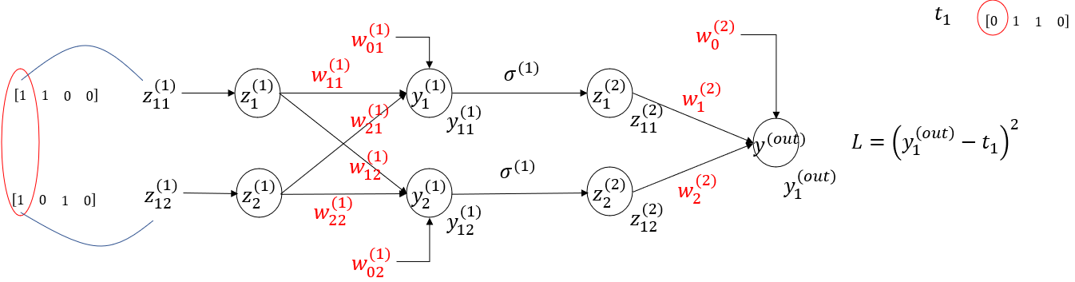


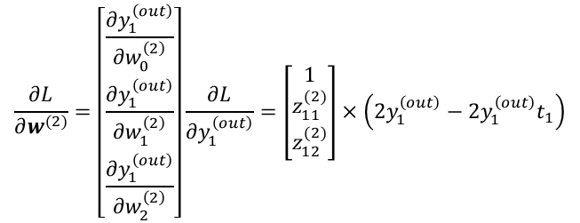

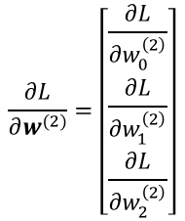


$\frac{∂L}{∂w_{0}^{\left(2\right)}}$= $\frac{∂y_{1}^{\left(out\right)}}{∂w_{0}^{\left(2\right)}}$ $\frac{∂L}{∂y_{1}^{\left(out\right)}}$
$$\frac{∂L}{∂w^{(2)}}=\left[\begin{matrix}\frac{∂y_{1}^{\left(out\right)}}{∂w_{0}^{\left(2\right)}} \\ \frac{∂y_{1}^{\left(out\right)}}{∂w_{1}^{\left(2\right)}} \\ \frac{∂y_{1}^{\left(out\right)}}{∂w_{2}^{\left(2\right)}}\end{matrix}\right]\frac{∂L}{∂y_{1}^{\left(out\right)}}=\left[\begin{matrix}1 \\ z_{11}^{(2)} \\ z_{12}^{(2)}\end{matrix}\right]×\left(2y_{1}^{\left(out\right)}−2y_{1}^{\left(out\right)}t_{1}\right)$$
$\frac{∂L}{∂w_{1}^{\left(2\right)}}$= $\frac{∂y_{1}^{\left(out\right)}}{∂w_{1}^{\left(2\right)}}$ $\frac{∂L}{∂y_{1}^{\left(out\right)}}$
$\frac{∂L}{∂w_{2}^{\left(2\right)}}$= $\frac{∂y_{1}^{\left(out\right)}}{∂w_{2}^{\left(2\right)}}$ $\frac{∂L}{∂y_{1}^{\left(out\right)}}$
$$(3, 1)$$
$$(1, 1)$$
$$\frac{∂L}{∂w^{(2)}}=\left[\begin{matrix}\frac{∂L}{∂w_{0}^{\left(2\right)}} \\ \frac{∂L}{∂w_{1}^{\left(2\right)}} \\ \frac{∂L}{∂w_{2}^{\left(2\right)}}\end{matrix}\right]$$

Slide 7

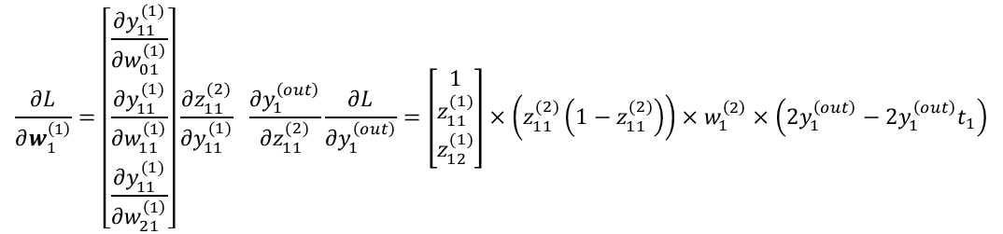

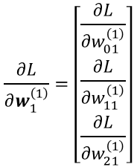



$\frac{∂L}{∂w_{01}^{\left(1\right)}}$= $\frac{∂y_{11}^{(1)}}{∂w_{01}^{\left(1\right)}}$ $\frac{∂z_{11}^{(2)}}{∂y_{11}^{(1)}}$ $\frac{∂y_{1}^{\left(out\right)}}{∂z_{11}^{(2)}}\frac{∂L}{∂y_{1}^{\left(out\right)}}$
$$\frac{∂L}{∂w_{1}^{\left(1\right)}}=\left[\begin{matrix}\frac{∂y_{11}^{(1)}}{∂w_{01}^{\left(1\right)}} \\ \frac{∂y_{11}^{(1)}}{∂w_{11}^{\left(1\right)}} \\ \frac{∂y_{11}^{(1)}}{∂w_{21}^{\left(1\right)}}\end{matrix}\right]\frac{∂z_{11}^{(2)}}{∂y_{11}^{(1)}} \frac{∂y_{1}^{\left(out\right)}}{∂z_{11}^{(2)}}\frac{∂L}{∂y_{1}^{\left(out\right)}}=\left[\begin{matrix}1 \\ z_{11}^{(1)} \\ z_{12}^{(1)}\end{matrix}\right]×\left(z_{11}^{(2)}\left(1−z_{11}^{(2)}\right)\right)×w_{1}^{\left(2\right)}×\left(2y_{1}^{\left(out\right)}−2y_{1}^{\left(out\right)}t_{1}\right)$$
$\frac{∂L}{∂w_{11}^{\left(1\right)}}$= $\frac{∂y_{11}^{(1)}}{∂w_{11}^{\left(1\right)}}$ $\frac{∂z_{11}^{(2)}}{∂y_{11}^{(1)}}$ $\frac{∂y_{1}^{\left(out\right)}}{∂z_{11}^{(2)}}\frac{∂L}{∂y_{1}^{\left(out\right)}}$
$\frac{∂L}{∂w_{21}^{\left(1\right)}}$= $\frac{∂y_{11}^{(1)}}{∂w_{21}^{\left(1\right)}}$ $\frac{∂z_{11}^{(2)}}{∂y_{11}^{(1)}}$ $\frac{∂y_{1}^{\left(out\right)}}{∂z_{11}^{(2)}}\frac{∂L}{∂y_{1}^{\left(out\right)}}$
$$(3, 1)$$
$$(1, 1)$$
$$(1, 1)$$
$$(1, 1)$$
$$\frac{∂L}{∂w_{1}^{\left(1\right)}}=\left[\begin{matrix}\frac{∂L}{∂w_{01}^{\left(1\right)}} \\ \frac{∂L}{∂w_{11}^{\left(1\right)}} \\ \frac{∂L}{∂w_{21}^{\left(1\right)}}\end{matrix}\right]$$

Slide 8

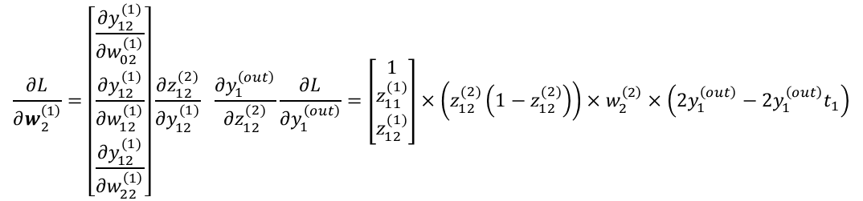

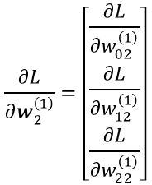

$\frac{∂L}{∂w_{02}^{\left(1\right)}}$= $\frac{∂y_{12}^{(1)}}{∂w_{02}^{\left(1\right)}}$ $\frac{∂z_{12}^{(2)}}{∂y_{12}^{(1)}}$ $\frac{∂y_{1}^{\left(out\right)}}{∂z_{12}^{(2)}}\frac{∂L}{∂y_{1}^{\left(out\right)}}$
$$\frac{∂L}{∂w_{2}^{\left(1\right)}}=\left[\begin{matrix}\frac{∂y_{12}^{(1)}}{∂w_{02}^{\left(1\right)}} \\ \frac{∂y_{12}^{(1)}}{∂w_{12}^{\left(1\right)}} \\ \frac{∂y_{12}^{(1)}}{∂w_{22}^{\left(1\right)}}\end{matrix}\right]\frac{∂z_{12}^{(2)}}{∂y_{12}^{(1)}} \frac{∂y_{1}^{\left(out\right)}}{∂z_{12}^{(2)}}\frac{∂L}{∂y_{1}^{\left(out\right)}}=\left[\begin{matrix}1 \\ z_{11}^{(1)} \\ z_{12}^{(1)}\end{matrix}\right]×\left(z_{12}^{(2)}\left(1−z_{12}^{(2)}\right)\right)×w_{2}^{\left(2\right)}×\left(2y_{1}^{\left(out\right)}−2y_{1}^{\left(out\right)}t_{1}\right)$$
$\frac{∂L}{∂w_{12}^{\left(1\right)}}$= $\frac{∂y_{12}^{(1)}}{∂w_{12}^{\left(1\right)}}$ $\frac{∂z_{12}^{(2)}}{∂y_{12}^{(1)}}$ $\frac{∂y_{1}^{\left(out\right)}}{∂z_{12}^{(2)}}\frac{∂L}{∂y_{1}^{\left(out\right)}}$
$\frac{∂L}{∂w_{22}^{\left(1\right)}}$= $\frac{∂y_{12}^{(1)}}{∂w_{22}^{\left(1\right)}}$ $\frac{∂z_{12}^{(2)}}{∂y_{12}^{(1)}}$ $\frac{∂y_{1}^{\left(out\right)}}{∂z_{12}^{(2)}}\frac{∂L}{∂y_{1}^{\left(out\right)}}$
$$(3, 1)$$
$$(1, 1)$$
$$(1, 1)$$
$$(1, 1)$$
$$\frac{∂L}{∂w_{2}^{\left(1\right)}}=\left[\begin{matrix}\frac{∂L}{∂w_{02}^{\left(1\right)}} \\ \frac{∂L}{∂w_{12}^{\left(1\right)}} \\ \frac{∂L}{∂w_{22}^{\left(1\right)}}\end{matrix}\right]$$

Slide 9
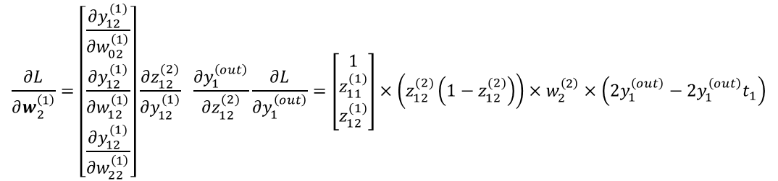
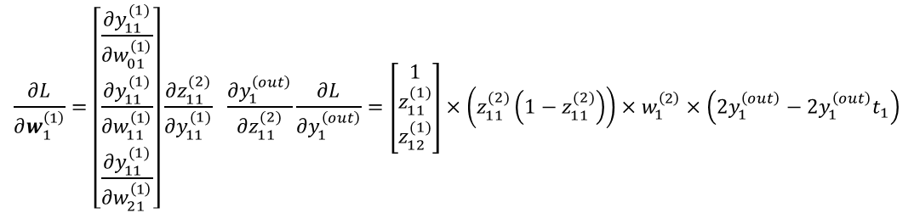
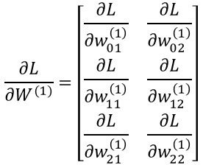
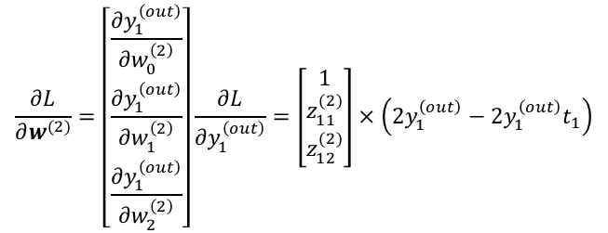
$$\frac{∂L}{∂w^{(2)}}=\left[\begin{matrix}\frac{∂y_{1}^{\left(out\right)}}{∂w_{0}^{\left(2\right)}} \\ \frac{∂y_{1}^{\left(out\right)}}{∂w_{1}^{\left(2\right)}} \\ \frac{∂y_{1}^{\left(out\right)}}{∂w_{2}^{\left(2\right)}}\end{matrix}\right]\frac{∂L}{∂y_{1}^{\left(out\right)}}=\left[\begin{matrix}1 \\ z_{11}^{(2)} \\ z_{12}^{(2)}\end{matrix}\right]×\left(2y_{1}^{\left(out\right)}−2y_{1}^{\left(out\right)}t_{1}\right)$$
$$\frac{∂L}{∂W^{(1)}}=\left[\begin{matrix}\frac{∂L}{∂w_{01}^{\left(1\right)}} & \frac{∂L}{∂w_{02}^{\left(1\right)}} \\ \frac{∂L}{∂w_{11}^{\left(1\right)}} & \frac{∂L}{∂w_{12}^{\left(1\right)}} \\ \frac{∂L}{∂w_{21}^{\left(1\right)}} & \frac{∂L}{∂w_{22}^{\left(1\right)}}\end{matrix}\right]$$
$$\frac{∂L}{∂w_{1}^{\left(1\right)}}=\left[\begin{matrix}\frac{∂y_{11}^{(1)}}{∂w_{01}^{\left(1\right)}} \\ \frac{∂y_{11}^{(1)}}{∂w_{11}^{\left(1\right)}} \\ \frac{∂y_{11}^{(1)}}{∂w_{21}^{\left(1\right)}}\end{matrix}\right]\frac{∂z_{11}^{(2)}}{∂y_{11}^{(1)}} \frac{∂y_{1}^{\left(out\right)}}{∂z_{11}^{(2)}}\frac{∂L}{∂y_{1}^{\left(out\right)}}=\left[\begin{matrix}1 \\ z_{11}^{(1)} \\ z_{12}^{(1)}\end{matrix}\right]×\left(z_{11}^{(2)}\left(1−z_{11}^{(2)}\right)\right)×w_{1}^{\left(2\right)}×\left(2y_{1}^{\left(out\right)}−2y_{1}^{\left(out\right)}t_{1}\right)$$
공통된 부분이 있으니까
다시 벡터나 행렬로 합쳐
표현하면 더
간단히 표현될 수 있지 않을까?
$$\frac{∂L}{∂w_{2}^{\left(1\right)}}=\left[\begin{matrix}\frac{∂y_{12}^{(1)}}{∂w_{02}^{\left(1\right)}} \\ \frac{∂y_{12}^{(1)}}{∂w_{12}^{\left(1\right)}} \\ \frac{∂y_{12}^{(1)}}{∂w_{22}^{\left(1\right)}}\end{matrix}\right]\frac{∂z_{12}^{(2)}}{∂y_{12}^{(1)}} \frac{∂y_{1}^{\left(out\right)}}{∂z_{12}^{(2)}}\frac{∂L}{∂y_{1}^{\left(out\right)}}=\left[\begin{matrix}1 \\ z_{11}^{(1)} \\ z_{12}^{(1)}\end{matrix}\right]×\left(z_{12}^{(2)}\left(1−z_{12}^{(2)}\right)\right)×w_{2}^{\left(2\right)}×\left(2y_{1}^{\left(out\right)}−2y_{1}^{\left(out\right)}t_{1}\right)$$

Slide 10
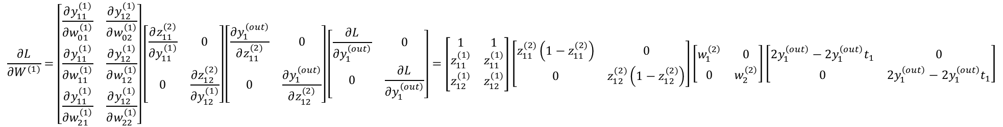
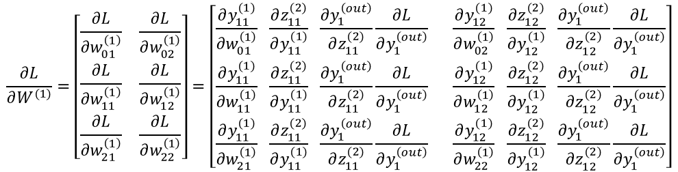
$$\frac{∂L}{∂W^{(1)}}=\left[\begin{matrix}\frac{∂y_{11}^{(1)}}{∂w_{01}^{\left(1\right)}} & \frac{∂y_{12}^{(1)}}{∂w_{02}^{\left(1\right)}} \\ \frac{∂y_{11}^{(1)}}{∂w_{11}^{\left(1\right)}} & \frac{∂y_{12}^{(1)}}{∂w_{12}^{\left(1\right)}} \\ \frac{∂y_{11}^{(1)}}{∂w_{21}^{\left(1\right)}} & \frac{∂y_{12}^{(1)}}{∂w_{22}^{\left(1\right)}}\end{matrix}\right]\left[\begin{matrix}\frac{∂z_{11}^{(2)}}{∂y_{11}^{(1)}} & 0 \\ 0 & \frac{∂z_{12}^{(2)}}{∂y_{12}^{(1)}}\end{matrix}\right]\left[\begin{matrix}\frac{∂y_{1}^{\left(out\right)}}{∂z_{11}^{(2)}} & 0 \\ 0 & \frac{∂y_{1}^{\left(out\right)}}{∂z_{12}^{(2)}}\end{matrix}\right]\left[\begin{matrix}\frac{∂L}{∂y_{1}^{\left(out\right)}} & 0 \\ 0 & \frac{∂L}{∂y_{1}^{\left(out\right)}}\end{matrix}\right]=\left[\begin{matrix}1 & 1 \\ z_{11}^{(1)} & z_{11}^{(1)} \\ z_{12}^{(1)} & z_{12}^{(1)}\end{matrix}\right]\left[\begin{matrix}z_{11}^{(2)}\left(1−z_{11}^{(2)}\right) & 0 \\ 0 & z_{12}^{(2)}\left(1−z_{12}^{(2)}\right)\end{matrix}\right]\left[\begin{matrix}w_{1}^{\left(2\right)} & 0 \\ 0 & w_{2}^{\left(2\right)}\end{matrix}\right]\left[\begin{matrix}2y_{1}^{\left(out\right)}−2y_{1}^{\left(out\right)}t_{1} & 0 \\ 0 & 2y_{1}^{\left(out\right)}−2y_{1}^{\left(out\right)}t_{1}\end{matrix}\right]$$
XOR 첫 번째 입력데이터
비선형변환 미분
2번째 선형변환 가중치
$$\frac{∂L}{∂W^{(1)}}=\left[\begin{matrix}\frac{∂L}{∂w_{01}^{\left(1\right)}} & \frac{∂L}{∂w_{02}^{\left(1\right)}} \\ \frac{∂L}{∂w_{11}^{\left(1\right)}} & \frac{∂L}{∂w_{12}^{\left(1\right)}} \\ \frac{∂L}{∂w_{21}^{\left(1\right)}} & \frac{∂L}{∂w_{22}^{\left(1\right)}}\end{matrix}\right]=\left[\begin{matrix}\frac{∂y_{11}^{(1)}}{∂w_{01}^{\left(1\right)}} \frac{∂z_{11}^{(2)}}{∂y_{11}^{(1)}} \frac{∂y_{1}^{\left(out\right)}}{∂z_{11}^{(2)}}\frac{∂L}{∂y_{1}^{\left(out\right)}} & \frac{∂y_{12}^{(1)}}{∂w_{02}^{\left(1\right)}} \frac{∂z_{12}^{(2)}}{∂y_{12}^{(1)}} \frac{∂y_{1}^{\left(out\right)}}{∂z_{12}^{(2)}}\frac{∂L}{∂y_{1}^{\left(out\right)}} \\ \frac{∂y_{11}^{(1)}}{∂w_{11}^{\left(1\right)}} \frac{∂z_{11}^{(2)}}{∂y_{11}^{(1)}} \frac{∂y_{1}^{\left(out\right)}}{∂z_{11}^{(2)}}\frac{∂L}{∂y_{1}^{\left(out\right)}} & \frac{∂y_{12}^{(1)}}{∂w_{12}^{\left(1\right)}} \frac{∂z_{12}^{(2)}}{∂y_{12}^{(1)}} \frac{∂y_{1}^{\left(out\right)}}{∂z_{12}^{(2)}}\frac{∂L}{∂y_{1}^{\left(out\right)}} \\ \frac{∂y_{11}^{(1)}}{∂w_{21}^{\left(1\right)}} \frac{∂z_{11}^{(2)}}{∂y_{11}^{(1)}} \frac{∂y_{1}^{\left(out\right)}}{∂z_{11}^{(2)}}\frac{∂L}{∂y_{1}^{\left(out\right)}} & \frac{∂y_{12}^{(1)}}{∂w_{22}^{\left(1\right)}} \frac{∂z_{12}^{(2)}}{∂y_{12}^{(1)}} \frac{∂y_{1}^{\left(out\right)}}{∂z_{12}^{(2)}}\frac{∂L}{∂y_{1}^{\left(out\right)}}\end{matrix}\right]$$
행렬로 표현한 오차역전파 표기로 손실함수에 대한
가중치에 대한 미분을 각각 계산하지 않아도됌.
2. 연쇄법칙으로 각 단계에서의 미분의 곱으로 나타나며
3. 이 또한 전파(propagation) 계산할 때 계산된 값을 메모리에
저장 후 불러와서 사용하므로 계산 효율을 극대화함.

Slide 11
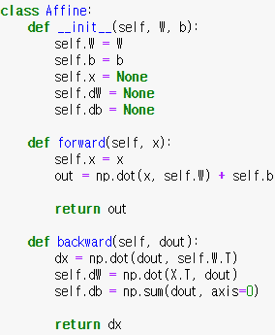
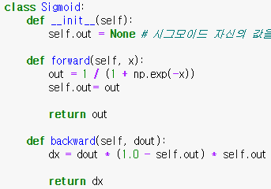
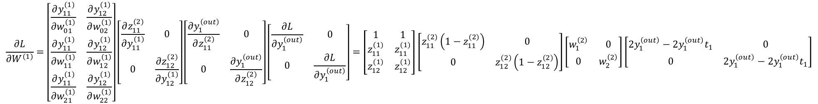
$$\frac{∂L}{∂W^{(1)}}=\left[\begin{matrix}\frac{∂y_{11}^{(1)}}{∂w_{01}^{\left(1\right)}} & \frac{∂y_{12}^{(1)}}{∂w_{02}^{\left(1\right)}} \\ \frac{∂y_{11}^{(1)}}{∂w_{11}^{\left(1\right)}} & \frac{∂y_{12}^{(1)}}{∂w_{12}^{\left(1\right)}} \\ \frac{∂y_{11}^{(1)}}{∂w_{21}^{\left(1\right)}} & \frac{∂y_{12}^{(1)}}{∂w_{22}^{\left(1\right)}}\end{matrix}\right]\left[\begin{matrix}\frac{∂z_{11}^{(2)}}{∂y_{11}^{(1)}} & 0 \\ 0 & \frac{∂z_{12}^{(2)}}{∂y_{12}^{(1)}}\end{matrix}\right]\left[\begin{matrix}\frac{∂y_{1}^{\left(out\right)}}{∂z_{11}^{(2)}} & 0 \\ 0 & \frac{∂y_{1}^{\left(out\right)}}{∂z_{12}^{(2)}}\end{matrix}\right]\left[\begin{matrix}\frac{∂L}{∂y_{1}^{\left(out\right)}} & 0 \\ 0 & \frac{∂L}{∂y_{1}^{\left(out\right)}}\end{matrix}\right]=\left[\begin{matrix}1 & 1 \\ z_{11}^{(1)} & z_{11}^{(1)} \\ z_{12}^{(1)} & z_{12}^{(1)}\end{matrix}\right]\left[\begin{matrix}z_{11}^{(2)}\left(1−z_{11}^{(2)}\right) & 0 \\ 0 & z_{12}^{(2)}\left(1−z_{12}^{(2)}\right)\end{matrix}\right]\left[\begin{matrix}w_{1}^{\left(2\right)} & 0 \\ 0 & w_{2}^{\left(2\right)}\end{matrix}\right]\left[\begin{matrix}2y_{1}^{\left(out\right)}−2y_{1}^{\left(out\right)}t_{1} & 0 \\ 0 & 2y_{1}^{\left(out\right)}−2y_{1}^{\left(out\right)}t_{1}\end{matrix}\right]$$
2번째 선형변환에 대한 2번째 은닉층의 입력에 대한 미분
(이전 은닉층으로 오차역전파를 하기 위함)
1번째 선형변환에 대한
가중치 파라미터 미분
지금의 논의에서는 XOR 데이터 1개에 대해서 진행한 결과임.
이를 데이터 4개로 확장하여 전개하면 아래와 같은 일반적인 선형변환 비선형변환 코드를 유도할 수 있음

